Slide 1
Inheritance

Slide 2
Inheritance: Introduction
Reusability--building new components by utilizing existing components- is yet another important aspect of OO paradigm.
It is always good/ “productive” if we are able to reuse something that is already exists rather than creating the same all over again.
This is achieve by creating new classes, reusing the properties of existing classes.
It saves money , time etc.
To use a class that is already created and tested properly saves the effort of testing and developing same again.
In C++ one class is tested and adapted properly can be used by the programmers to suit there requirements.

Slide 3
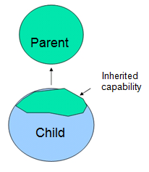
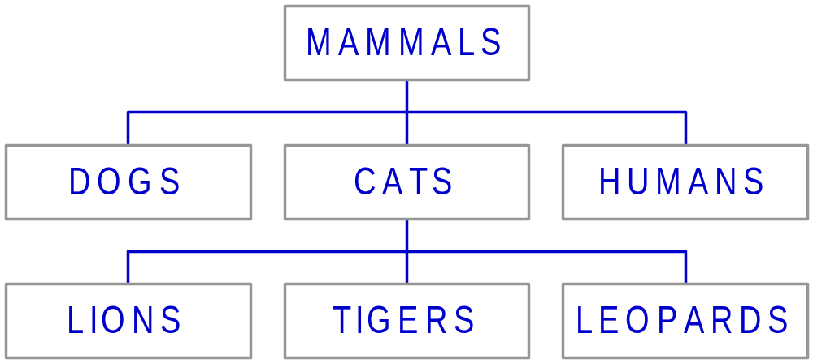
Definition
This mechanism of deriving a new class from existing/old class is called “inheritance”.
The old class is known as “base” class, “super” class or “parent” class”
The new class is known as “sub” class “derived” class, or “child”
class.
Example:

Slide 4
Define a Class Hierarchy
Syntax:
class DerivedClassName : access-level BaseClassName
where
  access-level specifies the type of derivation
    private by default, or
    public
Any class can serve as a base class
  Thus a derived class can also be a base class

Slide 5
Implementing Inheritance in C++ by Deriving Classes From the Base Class
Syntax:
class <base_class>
{
…
};
class <derived_class> : <access-specifier>
<base_class>
{
...
};

Slide 6
Single level Inheritance
Multilevel Inheritance
Multiple Inheritance
Hierarchal Inheritance

Slide 7
Public Access Specifier
Defines that all the:
  private members of a base class remain private in the object
  protected members remain protected
  the public members remain public

Slide 8
Protected Access Specifier
Defines that all the:
  the private members of a base class remain private in the object
  the protected members remain protected
  but all the public members of the base class become protected

Slide 9
Private Specifier
Defines that all the:
  private members of a base class remain private in the object
  public and protected members in the base class become private

Slide 10
Inheritance Concept
class Rectangle{
private:
int numVertices;
float *xCoord, *yCoord;
public:
void set(float *x, float *y, int nV);
float area();
};
Polygon
Rectangle
Triangle
class Polygon{
private:
int numVertices;
float *xCoord, *yCoord;
public:
void set(float *x, float *y, int nV);
};
class Triangle{
private:
int numVertices;
float *xCoord, *yCoord;
public:
void set(float *x, float *y, int nV);
float area();
};

Slide 11
Inheritance Concept
class Polygon{
protected:
int numVertices;
float *xCoord, float *yCoord;
public:
void set(float *x, float *y, int nV);
};
Polygon
Rectangle
Triangle
class Rectangle{
protected:
int numVertices;
float *xCoord, float *yCoord;
public:
void set(float *x, float *y, int nV);
float area();
};
class Rectangle : public Polygon{
public:
float area();
};

Slide 12
Inheritance Concept
class Polygon{
protected:
int numVertices;
float *xCoord, float *yCoord;
public:
void set(float *x, float *y, int nV);
};
Polygon
Rectangle
Triangle
class Triangle{
protected:
int numVertices;
float *xCoord, float *yCoord;
public:
void set(float *x, float *y, int nV);
float area();
};
class Triangle : public Polygon{
public:
float area();
};

Slide 13
Inheritance Relationship (Contd.)
The types of inheritance are:
Single inheritance
Is displayed when a class inherits attributes from a single class
Multilevel inheritance
A
B
A
B
C

Slide 14
Hierarchical inheritance
Hybrid inheritance
Multiple inheritance
A
B
C
D
A
B
C

Slide 15
example
Class base_class
{
Private:
Int num1;
Public:
Void base_read()
{
Cout<<enter a no”;
Cin>>num1;
}
Void base_show()
{
Cout<<“number is”<<num1;
}
} ;

Slide 16
Class derived_class:public base_class
{
Private:
Int num2;
Public:
Void derived_read()
{
Cout<<“enter no”;
Cin>>num2;
}
Void derived_show()
{
Cout<<“no is”<<num2;
}
};

Slide 17
void main()
{
derived_class d1;
d1.base_read();
d1.derived_read();
d1.base_show();
d1.derived_show();
getch();
}

Slide 18
Multiple Inheritance
Is the phenomenon where a class may inherit from two or more classes
Syntax:
class derived : public base1, public base2
{
//Body of class
};

Slide 19
multiple
Class base1
{
protected:
int a;
public:
void show()
{
cout<<“value is”<<a;
}
};

Slide 20
Class base2
{
protected:
int b;
public:
void display()
{
cout<<“value is”<<b;
}
};

Slide 21
Class derived:public base1,public base2
{
public:
Void setdata(int x,int y)
{
a=x;
b=y
}
};

Slide 22
Void main()
{
Derived d;
d.setdata(10,20);
d.show();
d.dispaly();
Getch();
}

Slide 23
Overriding member functions
Inheritance help us to add or replace the functionality of the existing base class.
Functionality to the existing base class can be added by defining the new member functions explicitly in the derived class which are distinct from the members of the base class.
However in certain situations we want to replace the functionality of the base class.

Slide 24
This can be achieved by overriding /redefining the member function in the derived class.

Slide 25
Ambiguities in Multiple Inheritance
  Can arise when two base classes contain a function of the same name
  Can arise when the derived class has multiple copies of the same base class
Class A
Class B
Class C
Class D

Slide 26
What to inherit?
In principle, every member of a base class is inherited by a derived class
  just with different access permission
However, there are exceptions for
  constructor and destructor
  operator=() member
  friends
Since all these functions are class-specific

Slide 27
Access specifiers of derivation
  The public access specifier
  The protected access specifier
  The private access specifier
Sequence of invoking constructors and destructors
  Constructors are called in the order of Base – to – Derived
  Destructors are called in the order of Derived – to – Base

Slide 28
Access Rights of Derived Classes
Type of Inheritance
 | private | protected | public
private | - | - | -
protected | private | protected | protected
public | private | protected | public
Access Control
for Members
The type of inheritance defines the access level for the members of derived class that are inherited from the base class

Slide 29
Constructor Rules for Derived Classes
The default constructor and the destructor of the base class are always called when a new object of a derived class is created or destroyed.
class A {
public:
A ( )
{cout<< “A:default”<<endl;}
A (int a)
{cout<<“A:parameter”<<endl;}
};
class B : public A
{
public:
B (int a)
{cout<<“B”<<endl;}
};
output:
A:default
B
B test(1);

Slide 30
Constructor Rules for Derived Classes
You can also specify an constructor of the base class other than the default constructor
  DerivedClassCon ( derivedClass args ) : BaseClassCon ( baseClass args )
  { DerivedClass constructor body }
class A {
public:
A ( )
{cout<< “A:default”<<endl;}
A (int a)
{cout<<“A:parameter”<<endl;}
};
class C : public A {
public:
C (int a) : A(a)
{cout<<“C”<<endl;}
};
output:
A:parameter
C
C test(1);

Slide 31
http://www.slideworld.com/slideshow.aspx/OOPS-INHERITANCE-ppt-2768891#

Slide 32
Ambiguities in Multiple Inheritance (Contd.)
Can arise when two base classes contain a function of the same name
Example:
#include<iostream>
  class base1
  {
  public:
  void disp()
  {
  cout << "Base1" <<endl;
  }
  };

Slide 33
Ambiguities in Multiple Inheritance (Contd.)
  class base2
  {
  public:
  void disp()
  {
  cout << "Base2"<<endl;
  }
  };
  class derived : public base1,public base2
  {
  //Empty class
  };

Slide 34
Ambiguities in Multiple Inheritance (Contd.)
  int main()
  {
  derived Dvar;
  Dvar.disp(); //Ambiguous function call
  return 0;
}

Slide 35
Ambiguities in Multiple Inheritance (Contd.)
Can be resolved in two ways:
  By using the scope resolution operator
    D1.base1::disp();
    D1.base2::disp();
        OR
        Defining explicitly member function
  By overriding the function in the derived class
    Void disp()
    {
    base1::disp();
    base2::disp();
    }

Slide 36
class person
{
private:
char name[10];
int phn;
public:
void read()
{
cout<<“enter name n phn no”;
cin>>name>>phn;
}
void show()
{
cout<<“name is”<<name<<endl;
cout<<“phn no”<<phn;
};

Slide 37
class student
{
private:
int rollno;
char course;
public:
void read()
{
cout<<“enter roll no and course”;
cin>>rollno>>course;
}
void show()
{
cout<<“rollno is”<<rollno<<endl;
cout<<“course is”<<course;
}
};

Slide 38
class info:public student,public person
{
void inputdata()
{
person::read();
student::read();
cout<<“enter gender”;
cin>>gender;
}

Slide 39
void outputdata()
{
person::show();
student::show();
cout<<gender is<<gender;
}
};
void main()
{
info obj;
obj.inputdata();
obj.outputdata();
getch();
}

Slide 40

  Can arise when the derived class has multiple copies of the same base class
Class A
Class B
Class C
Class D

Slide 41
Solution
Virtual Base Class
When same class is inherited more tham once via multiple paths, multiple copies of the base class member are created in memory. By declaring the base class as virtual only 1 copy of the base classis inherited
  Allows to have only one copy of the base class members in memory when a class inherits same properties or methods more than once through multiple paths
  Is implemented by using the virtual qualifier when inheriting from the base class

Slide 42
Class a
{….};
Class b:virtual public a
{……};
Class c:virtual public a
{……};
Class d:public b,public c
{………..};

Slide 43
Invocation of Constructors
Is done in the following order:
1. Virtual base class constructors – in the order of inheritance
2. Non-virtual base class constructors – in the order of inheritance
3. Member objects' constructors – in the order of declaration
4. Derived class constructors

Slide 44
class grandparent
{
protected:
int base_data;
public:
void readgp()
{
cout<<“enter data of grand parent”;
cin>>base_data;
}
};

Slide 45
Class parent1:virtual public grandparent
{
protected:
int parent1_data;
public:
void read1()
{
cout<<“enter data of parent1”;
cin>>parent1_data;
}
};

Slide 46
Class parent2:virtual public grandparent
{
protected:
int parent2_data;
public:
void read2()
{
cout<<“enter data of parent2”;
cin>>parent2_data;
}
};

Slide 47
class child:public parent1,public parent2
{
private :
int sum;
public:
int add()
{
sum=base_data+parent1_data+parent2_data;
}
void show()
{
cout<<sum;
}
};

Slide 48
void main()
{
child c1;
c1.readgp();
c1.read1();
c1.read2();
c1.add();
c1.show();
getch();
}

Slide 49
Abstract class-
In certain situations a programmer may create a class but never creates its object, such a class whose object can not be created is called abstract class
And whose object can be created is known as concrete class.
it is designed only to be inherited
Eg-A is base class which act as
abstract class
B and C are concrete class
A
B
C

